Slide 1
Computer Organization and Architecture Session 5
Dr. Lucy J. Gudino
WILP & Department of CS & IS

Slide 2
Today’s Session
Contact Hour | List of Topic Title | Text/Ref Book/external resource
9 | Instruction Sets: Characteristics and Functions Machine Instruction Characteristics Types of Operands Intel x86 and ARM Data Types Types of Operations Intel x86 and ARM Operation Types | T1: Ch10: 10.1 - 10.5
10 | Addressing x86 and ARM Addressing Modes Instruction Formats x86 and ARM Instruction Formats | T1: Ch11: 11.1 - 11.4

Slide 3
What is an Instruction Set?
The complete collection of instructions that are understood by a CPU
Machine Code
Binary
Usually represented by assembly codes
Notes:
2

Slide 4
Elements of an Instruction
Operation code (Op code)
Do this
Source Operand reference
To this
Result Operand reference
Put the answer here
Next Instruction Reference
When you have done that, do this...
Notes:
3
Operation code: Specifies the operation to be performed (e.g., ADD, I/O).
The operation is specified by a binary code, known as the operation code,
or opcode.
• Source operand reference: The operation may involve one or more source
operands, that is, operands that are inputs for the operation.
• Result operand reference: The operation may produce a result.
• Next instruction reference: This tells the processor where to fetch the next instruction
after the execution of this instruction is complete.

Slide 5
Source and Destination Operands
Can be in four areas
Main memory (or virtual memory or cache)
CPU register
I/O device
Immediate
Notes:
4
Main or virtual memory: As with next instruction references, the main or virtual
memory address must be supplied.
• Processor register:With rare exceptions, a processor contains one or more registers
that may be referenced by machine instructions. If only one register exists,
reference to it may be implicit. If more than one register exists, then each register
is assigned a unique name or number, and the instruction must contain the number
of the desired register.
• Immediate: The value of the operand is contained in a field in the instruction
being executed.
• I/O device: The instruction must specify the I/O module and device for the operation.
If memory-mapped I/O is used, this is just another main or virtual
memory address.

Slide 6
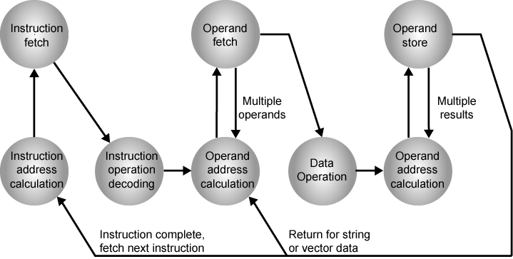
Instruction Cycle State Diagram

Slide 7
Instruction Representation
In machine code each instruction has a unique bit pattern
For human consumption (well, programmers anyway) a symbolic representation is used
e.g. ADD, SUB, LOAD
Operands can also be represented in this way
ADD A,B
Notes:
5

Slide 8
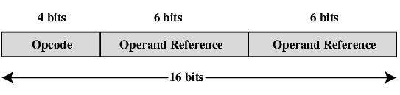
Simple Instruction Format
During instruction execution, an instruction is read into an instruction register (IR) in the processor.
The processor must be able to extract the data from the various instruction fields to perform the required operation.
Opcodes are represented by abbreviations, called mnemonics
Example: ADD AX, BX ➔ Add instruction
Operands can also be represented symobolically
Example ADD R, Y

Slide 9
Instruction Types
Data processing : Arithmetic and logic instructions
Data storage (main memory) : Movement of data into or out of register and or memory locations
Data movement (I/O) : I/O instructions
Program flow control : Test and branch instructions
Notes:
6

Slide 10
Number of Addresses (a)
3 addresses
Operand 1, Operand 2, Result
a = b + c;
May be a forth - next instruction (usually implicit)
Not common
Needs very long words to hold everything
Notes:
7

Slide 11
Number of Addresses (b)
2 addresses
One address doubles as operand and result
a = a + b
Reduces length of instruction
Requires some extra work
Temporary storage to hold some results
Notes:
8

Slide 12
Number of Addresses (c)
1 address
Implicit second address
Usually a register (accumulator)
Common on early machines
Notes:
9

Slide 13
Number of Addresses (d)
0 (zero) addresses
All addresses implicit
Uses a stack
e.g. c = a + b
push a
push b
add
pop c
Notes:
10

Slide 14
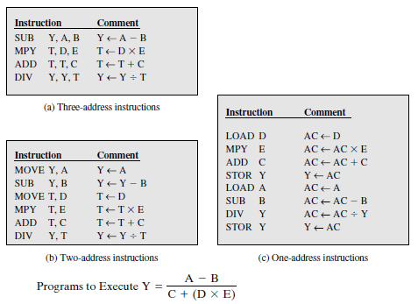
Example

Slide 15
How Many Addresses
More addresses
More complex (powerful?) instructions
More registers
Inter-register operations are quicker
Fewer instructions per program
Fewer addresses
Less complex (powerful?) instructions
More instructions per program
Faster fetch/execution of instructions
Notes:
11

Slide 16
Instruction set Design Decisions
Operation repertoire
How many ops?
What can they do?
How complex are they?
Data types
Instruction formats
Length of op code field
Number of addresses
Registers
Number of CPU registers available
Which operations can be performed on which registers?
Addressing modes
RISC v CISC
Notes:
12

Slide 17
Types of Operand
Machine instructions operate on data
Addresses
Numbers
Binary integer or binary fixed point, floating point, decimal
Characters
ASCII etc.
Logical Data
Bits or flags
Notes:
14
Addresses are, in fact, a form of data. In many cases, some calculation must be performed on the operand reference in an instruction to determine the main or virtual memory address. In this context, addresses can be considered to be unsigned integers.

Slide 18
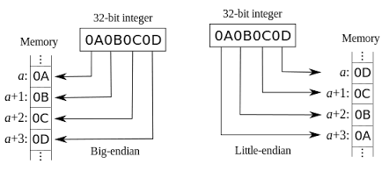
Byte Ordering

Slide 19
Intel x86 Data Types
8 bit (Byte)
16 bit (word)
32 bit (double word)
64 bit (quad word)
128 bit (double quad word)
Addressing is by 8 bit unit
A 32 bit double word is read at addresses divisible by 4
Notes:
15

Slide 20
x86 Specific Data Types
General - arbitrary binary contents
Integer - single binary value
Ordinal - unsigned integer
Unpacked BCD - One digit per byte
Packed BCD - 2 BCD digits per byte
Near Pointer - 32 bit offset within segment
Bit field
Byte String
Floating Point
Notes:
16

Slide 21
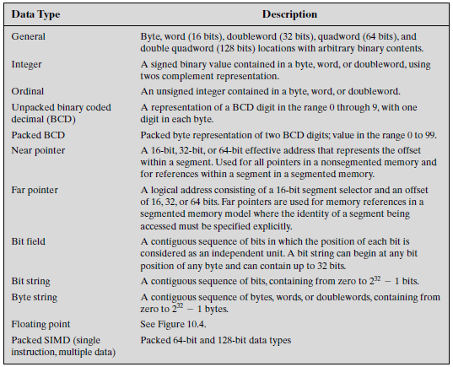

Slide 22
Contd…
To support multimedia applications the packed SIMD data types are introduced as extensions

Slide 23
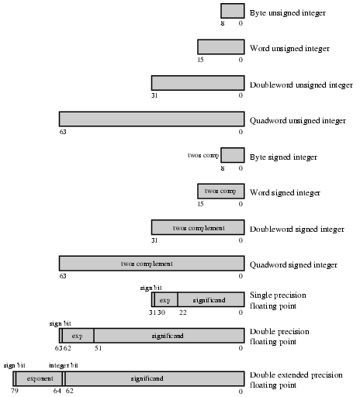
x86 Numeric Data Formats
Notes:
17

Slide 24
ARM Data types
ARM processors support data types of 8 (byte), 16 (halfword), and 32 (word) bits in length.
For all three data types an unsigned interpretation is supported, in which the value represents an unsigned, nonnegative integer.
All three data types can also be used for twos complement signed integers.
Majority of ARM processors do not provide floating point hardware ( uses floating point co processor)
Supports the single- and double-precision floating point data types defined in IEEE 754.

Slide 25
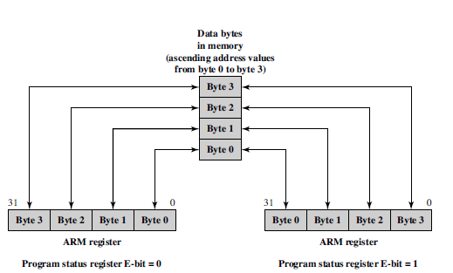
Contd…
ENDIAN Support:
Uses state bit E

Slide 26
Types of Operation
Data Transfer
Arithmetic
Logical
Conversion
I/O
System Control
Transfer of Control
Notes:
18

Slide 27
Data Transfer
Specify
Source
Destination
Amount of data
May be different instructions for different movements
e.g. IBM 370
Or one instruction and different addresses
e.g. VAX
Notes:
19

Slide 28
Arithmetic
Add, Subtract, Multiply, Divide
Signed Integer
Floating point ?
May include
Increment (a++)
Decrement (a--)
Negate (-a)
Notes:
20

Slide 29
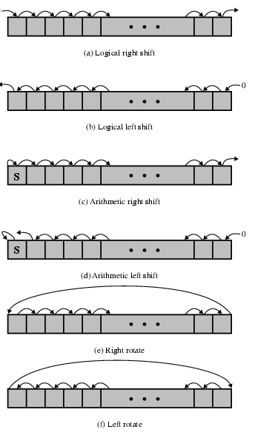
Shift and Rotate Operations

Slide 30
Logical
Bitwise operations
AND, OR, NOT
Notes:
21

Slide 31
Conversion
E.g. Binary to Decimal
Notes:
22

Slide 32
Input/Output
May be specific instructions
May be done using data movement instructions (memory mapped)
May be done by a separate controller (DMA)
Notes:
23

Slide 33
Systems Control
Privileged instructions
CPU needs to be in specific state
Ring 0 on 80386+
Kernel mode
For operating systems use
Notes:
24

Slide 34
Transfer of Control
Branch
e.g. branch to x if result is zero
Skip
e.g. increment and skip if zero
ISZ Register1
Branch xxxx
ADD A
Subroutine call
c.f. interrupt call
Notes:
25

Slide 35
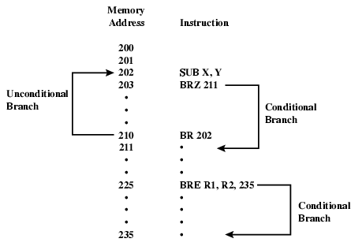
Branch Instruction

Slide 36
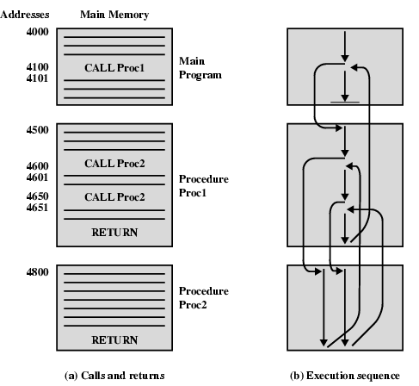
Nested Procedure Calls

Slide 37
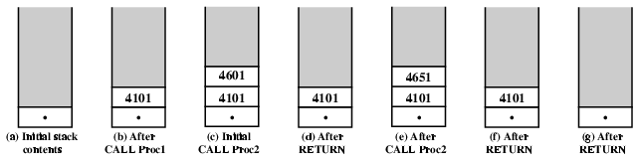
Use of Stack

Slide 38
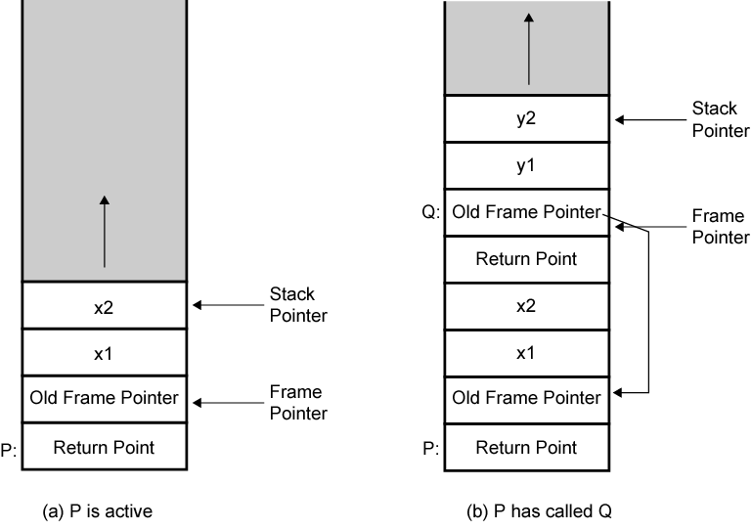
Stack Frame Growth Using Sample Procedures P and Q

Slide 39
Addressing Modes
Immediate
Direct
Indirect
Register
Register Indirect
Displacement (Indexed)
Stack
Notes:
2

Slide 40
Immediate Addressing
Operand is part of instruction
Operand = address field
e.g. ADD 5
Add 5 to contents of accumulator
5 is operand
No memory reference to fetch data
Fast
Limited range
Notes:
3

Slide 41
Immediate Addressing Diagram
Instruction
Opcode
Operand
Notes:
4

Slide 42
Direct Addressing
Address field contains address of operand
Effective address (EA) = address field (A)
e.g. ADD A
Add contents of cell A to accumulator
Look in memory at address A for operand
Single memory reference to access data
No additional calculations to work out effective address
Limited address space
Notes:
5

Slide 43
Direct Addressing Diagram
Instruction
Opcode
Address A
Memory
Operand
Notes:
6

Slide 44
Indirect Addressing (1)
Memory cell pointed to by address field contains the address of (pointer to) the operand
EA = (A)
Look in A, find address (A) and look there for operand
e.g. ADD (A)
Add contents of cell pointed to by contents of A to accumulator
Notes:
7

Slide 45
Indirect Addressing (2)
Large address space
2^{n} where n = word length
May be nested, multilevel, cascaded
e.g. EA = (((A)))
Multiple memory accesses to find operand
Hence slower
Notes:
8

Slide 46
Indirect Addressing Diagram
Instruction
Opcode
Address A
Memory
Pointer to operand
Operand
Notes:
9

Slide 47
Register Addressing (1)
Operand is held in register named in address filed
EA = R
Limited number of registers
Very small address field needed
Shorter instructions
Faster instruction fetch
Notes:
10

Slide 48
Register Addressing (2)
No memory access
Very fast execution
Very limited address space
Multiple registers helps performance
Requires good assembly programming or compiler writing
C programming
register int a;
Notes:
11

Slide 49
Register Addressing Diagram
Instruction
Opcode
Register Address R
Registers
Operand
Notes:
12

Slide 50
Register Indirect Addressing
Similar to indirect addressing
EA = (R)
Operand is in memory cell pointed to by contents of register R
Large address space (2^{n})
One fewer memory access than indirect addressing
Notes:
13

Slide 51
Register Indirect Addressing Diagram
Instruction
Opcode
Register Address R
Memory
Registers
Pointer to Operand
Operand
Notes:
14

Slide 52
Displacement Addressing
EA = A + (R)
Address field hold two values
A = base value
R = register that holds displacement
or vice versa
Notes:
15

Slide 53
Displacement Addressing Diagram
Instruction
Opcode
Register R
Address A
Memory
Registers
Pointer to Operand
+
Operand
Notes:
16

Slide 54
Relative Addressing
A version of displacement addressing
R = Program counter, PC
EA = A + (PC)
i.e. get operand from A cells from current location pointed to by PC
Notes:
17

Slide 55
Base-Register Addressing
A holds displacement
R holds pointer to base address
R may be explicit or implicit
e.g. segment registers in 80x86
Notes:
18

Slide 56
Indexed Addressing
A = base
R = displacement
EA = A + R
Good for accessing arrays
EA = A + R
R++
Notes:
19

Slide 57
Combinations
Postindex
EA = (A) + (R)
Preindex
EA = (A+(R))
(Draw the diagrams)
Notes:
20

Slide 58
Stack Addressing
Operand is (implicitly) on top of stack
e.g.
ADD Pop top two items from stack and add
Notes:
21

